Slide 1
AP-Side AoA-Assisted Dynamic RTS Threshold Adaptation for Hidden-Node in Wi-Fi
Professor Chien-Chao Tseng
Department of Computer Science
National Yang Ming Chiao Tung University
cctseng@cs.nycu.edu.tw

Slide 2
Outline
Introduction
Background
AoA-Assisted Dynamic RTS Threshold Adaptation
Evaluation
Conclusion

Slide 3
Outline
Introduction
Background
AoA-Assisted Dynamic RTS Threshold Adaptation
Evaluation
Conclusion

Slide 4


Hidden Nodes Problem and RTS/CTS
Hidden Node Problem
Devices can communicate with AP but cannot detect each other
When they transmit at the same time, their signals collide at the AP
Causes packet loss and lower throughput
Request To Send / Clear To Send (RTS/CTS)
Optional 802.11 handshake before data transmission
Makes nearby and hidden nodes defer, reducing collisions

Slide 5
RTS/CTS Workflow
RTS Threshold:
RTS/CTS 只有在封包大於這個 RTS Threshold的時候才會使用
Step:
Sender sends RTS to request channel access
Nearby node hearing RTS defers
AP sends CTS to grant transmission permission
Hidden node hearing CTS defers
Sender transmits data after the channel is reserved
Sender
AP
Hidden Node
1. RTS
1. RTS
2. CTS
2. CTS
Nearby Node
3. DATA
Request To Send / Clear To Send (RTS/CTS)
Notes:
RTS Threshold 是專有名詞
The use of the RTS/CTS mechanism is under control of the dot11RTSThreshold attribute. This attribute maybe set on a per-STA basis. This mechanism allows STAs to be configured to initiate RTS/CTS either always,never, or only on frames longer than a specified length.
https://mrncciew.com/wp-content/uploads/2014/10/ieee-802-11-2012.pdf#page=5.00

Slide 6
RTS Threshold Tuning
RTS/CTS handshake can also negatively impact performance sinceit introduces additional delay and overhead
standard does not specify what RTS threshold to use
There arealso cases where the RT value is set to the maximum frame size, sothat RTS/CTS is never used. However, 802.11 product manufacturers make recommendations to users that if they are experiencingdegraded performance, they should test their network with lowerRT values.
Could a better fixed value fix it? No single one fits all:
Too low → RTS/CTS everywhere → overhead even without hidden nodes
Too high → hidden-node collisions unprotected

Slide 7
Related Work
a number of studieshave explored techniques to dynamically set the value of the RT
investigates throughputperformance when using or not using RTS/CTS and have advocatedboth for and against the use of RTS/CTS
How effective is the IEEE 802.11 RTS/CTS handshake in ad hoc networks
explored how to dynamically set the RTSThreshold, RT
[9] Laura Huei-jiun Ju and Izhak Rubin. 2003. “The Effect of Disengaging RTS/CTS Dialogue in IEEE 802.11 MAC Protocol.” In International Conference on Wireless Networks, pp. 632–638.
A new dynamic scheme for efficient RTS threshold handling in wireless networks
A machine learning approach for dynamic control of RTS/CTS in WLANs

Slide 8
Prior work already tunes RTS/CTS dynamically with modified nodes:
On/off per frame — from contention [Edalat '18]
Tune the threshold value — from packet size / loss [Ahsan '10, AINA ‘08]
For/against analyses: RTS/CTS helps only sometimes [Ju&Rubin '03, Xu ’02]
Common shape:
Each node self-tunes from its OWN link stats (loss, traffic)
Distributed, per-node — set at the transmitter, no AP coordinationqw

Slide 9
Location Info Unused for RTS Control
Adaptive RTS threshold control already exists
Switch RTS/CTS on or off per frame
Tune the RTS threshold value
Prior work relies on link information only
E.g., Loss statistics or traffic models
No design uses location information
Notes:
要加上前面為什麼有人要調整 rts threshold
Aware sta location 是比 Move 正確的說法
----
論文都很舊 2006年

Slide 10
What every prior design misses — two blind spots:
1. Non-spatial
uses link info only (loss / traffic); never WHO is hidden from whom
Per-node & blind to the global picture
a self-tuning STA can't see its own hidden peers (by definition unheard) → can't separate hidden from contention, can't coordinate across STAs

Slide 11
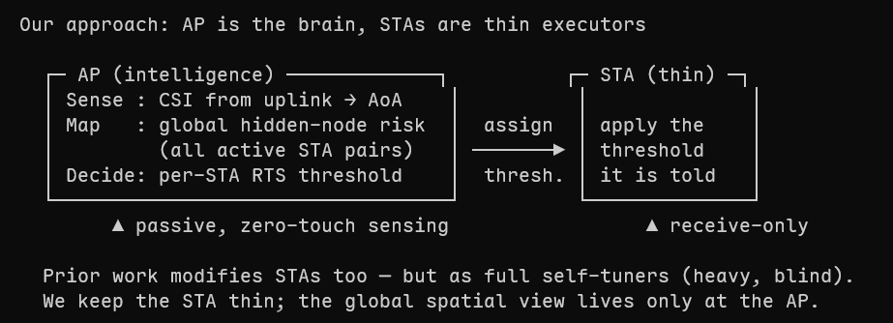
AP-side, global, spatial
Prior work also modifies stations — but makes each a full self-tuner. We keep the STA thin: the AP is the single brain with the global spatial view; the STA only applies the threshold it is told.
AP Sense Environment
Collect CSI
Estimate STA direction
Collect link information
AP Evaluate Risk
AP Update all STAs Threshold
Sense Environment
Evaluate
Risk
Update Threshold
Notes:
只能控制 AP side的RTS threshold是問題嗎?

Slide 12
Outline
Introduction
Background
Complex Baseband Signal
Channel State Information
AoA
Steering Vector
MUSIC
AoA-Assisted Dynamic RTS Threshold Adaptation
Evaluation
Conclusion

Slide 13
Story
STA send data to AP
And AP calculate AoA
Path 1
Path 2
Path 3

Slide 14
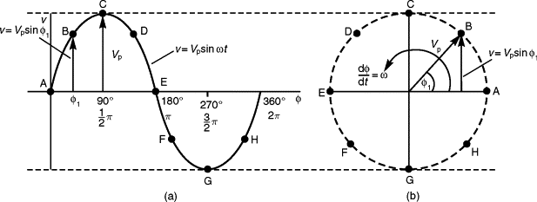

Carrier
Represented as a complex exponential $Ae^{Pi}$
$A$: Amplitude — signal strength relative to known transmitted wave
$P$: Phase — signal’s rotation relative to a known transmitted wave
Notes:
https://www.sciencedirect.com/topics/engineering/phasor-representation
CSI=transmitted reference signal / received signal​

Slide 15

Angle of Arrival (AoA): STA Direction
AoA tells STA's direction
AP measures AoA from normal uplink frames
Rays from a distant STA arrive parallel
Both antennas see the same angle
θ
θ
d
Notes:
天線可以調嗎? 可以調的話會改變 AoA

Slide 16
Wi-Fi Channel State Information (CSI)
Describes propagation process of the wireless signal
Contains geometric information
CSI is estimated from a known pattern
Sender transmits a pattern known to receiver
Receiver estimates CSI from received pattern
Path 1
Path 2
Path 3

Slide 17


Steering Vector: Direction's Fingerprint
Antennas hear signal at slightly different times
Each AoA has a predictable arrival pattern
Predicted pattern is Steering Vector
Compare measured CSI with every fingerprint
The best match is the AoA
θ
2$dsinθ$
$$dsinθ$$
d
d
Notes:
AP 天線可調整方向 會影響 Steering Vector 的計算或正確性嗎?

Slide 18
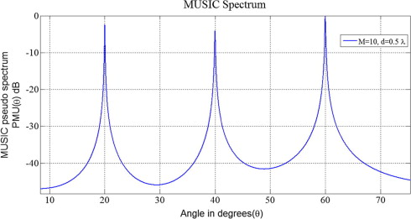
Multiple Signal Classification (MUSIC)
MUSIC is algorithm that estimates AoA from CSI
Widely used in Wi-Fi localization
MUSIC matches every angle's steering vector to CSI
Matching produces a spatial spectrum
Peaks indicate likely AoAs

Slide 19
Outline
Introduction
Background
AoA-Assisted Dynamic RTS Threshold Adaptation
Evaluation
Conclusion

Slide 20
Hidden-Node Risk Score
Risk computed for each active STA pair
Geometric information
AoA between two active STAs
Link information
Retry rate / RSSI / MCS / traffic activity
Risks aggregate into a BSS-level score
If the risk score over/less than a number change the rts threshold

Slide 21
Risk-Driven RTS Threshold Adaptation
The RTS Threshold value use - 標題:"(Exploiting) Packet Distribution based Tuning of RTS Threshold in IEEE 802.11"- 發表:ISCC '10(IEEE Symposium on Computers and Communications, 2010) method

Slide 22
Outline
Introduction
Background
AoA-Assisted Dynamic RTS Threshold Adaptation
Evaluation
Conclusion

Slide 23
Evaluation
Scenarios
Hidden-node
Non-hidden-node
Threshold Control Policy
Static RTS threshold
Dynamic RTS threshold
Disable RTS/CTS
Metrics
Throughput
Retry rate
Latency

Slide 24
Outline
Introduction
Background
AoA-Assisted Dynamic RTS Threshold Adaptation
Evaluation
Conclusion

Slide 25
Next Steps
Define risk scoring and score-to-threshold mapping
Reinforcement learning?
Adopt other MUSIC variant for AoA estimation
Speed up MUSIC
Define evaluation scenarios, baselines, and metrics

Slide 26
Appendix

Slide 27
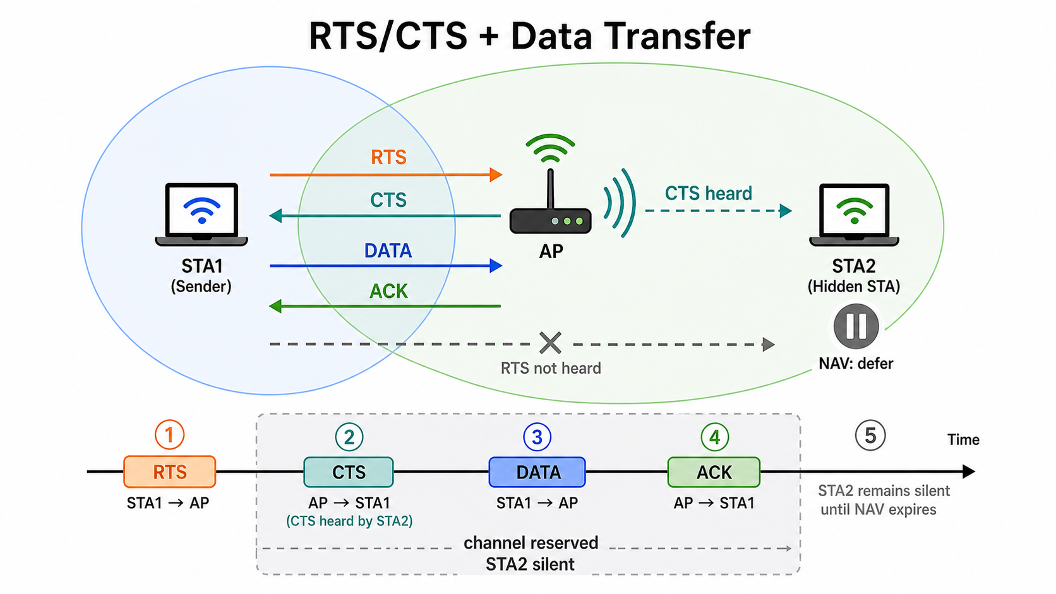
RTS/CTS Mitigates Hidden-Node Collisions
1. RTS
2. CTS
2. CTS
4. DATA
5. ACK

Slide 28
RTS/CTS Mitigates Hidden-Node Collisions
Optional 802.11 handshake before data transmission
RTS/CTS makes nearby nodes defer, reducing hidden-node collisions
Step:
Sender sends RTS to request channel access
Nearby node hearing RTS defers
AP sends CTS to grant transmission permission
Hidden node hearing CTS defers
Sender transmits data after the channel is reserved
Sender
AP
Hidden Node
1. RTS
1. RTS
2. CTS
2. CTS
Nearby Node
3. DATA
Request To Send / Clear To Send (RTS/CTS)

Slide 29
Antenna Timing Differences Reveal AoA
Antennas hear signal at slightly different times
Wave arrival pattern depends only on direction
Reading the pattern from CSI gives the AoA
θ
θ
d

Slide 30
CSI Representation
Represented as a complex exponential $Ae^{Pi}$
$A$: Amplitude — signal strength relative to known transmitted wave
$P$: Phase — signal’s rotation relative to a known transmitted wave
Notes:
https://www.sciencedirect.com/topics/engineering/phasor-representation
CSI=transmitted reference signal / received signal​

Slide 31
Spatial Spectrum Estimation Estimates AoA
Spatial spectrum estimation scores each angle by matching phase pattern to CSI
Phase pattern of each angle is called steering vector
Angle with the highest score is most likely signal's AoA
Multipath yields multiple peaks
Notes:
https://www.sciencedirect.com/science/article/pii/S209099771300031X

Slide 32
Classic Beamforming Hits a Resolution Wall
The straightforward scorer: shift each antenna's signal to align with a candidate angle, then sum - a true arrival from that angle adds up in phase (delay-and-sum beamforming)
Sweeping this listening beam across all angles gives the spatial spectrum - like turning an ear toward each direction
The beam's width is set by array size: with only 2-4 antennas it is roughly 60 degrees wide
Indoor paths arrive just 10-20 degrees apart, so they merge into one blob inside the wide beam
More antennas would sharpen the beam - but a commodity AP's antenna count is fixed

Slide 33
Why We Use MUSIC
MUSIC skips the beam entirely: it exploits the statistical structure of the received signal to test each angle directly, so resolution is not capped by antenna count
Faster alternatives fit poorly: ESPRIT's algebraic shortcut exists only for strictly regular arrays and degrades under heavy multipath; exhaustive-search ML is accurate but computationally infeasible
MUSIC works with any known antenna layout and stays robust in multipath; its heavier computation is affordable since localization does not need fast updates
Proven on our hardware class: SpotFi reaches ~40 cm median accuracy with 3 antennas using MUSIC
We therefore adopt MUSIC for AP-side AoA estimation

Slide 34
LRG1 Provides AP-Side Control and Measurements
LRG1 exposes the RTS threshold as the main AP-side control knob.
AP-side measurements include retry statistics, RSSI, CSI, AoA, and MCS.

Slide 35
Performance Analysis Separates Gains from Limits
Analyze when the method improves performance and when its benefit is limited.

